Slide 1


Prediction Challenge
- Brijesh Goharia

Slide 2

The Challenge
To predict with given data if the consumer enrolled in loyalty program will buy organic vegetables or not

Slide 3
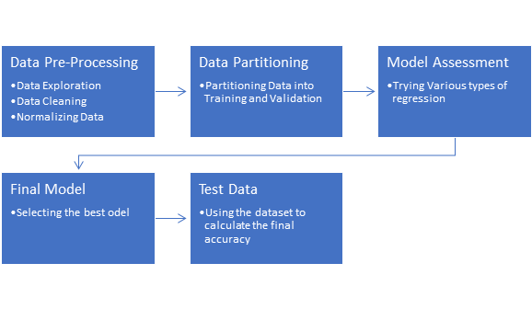
Flow chart of our approach

Slide 4

Data Pre-processing
On examining the dataset, we observed that data were missing in every variable.
Hence, we decided on trying out with different iterations by imputing/eliminating the missing/NA values
We imputed “ “ with NA in categorical variables for few models. Also, imputed the mode value for respective variable.
In numerical variables, we imputed the missing values with mean value of the respective variable
After brainstorming we came up with 8 different models to test, mentioned in the following slide

Slide 5
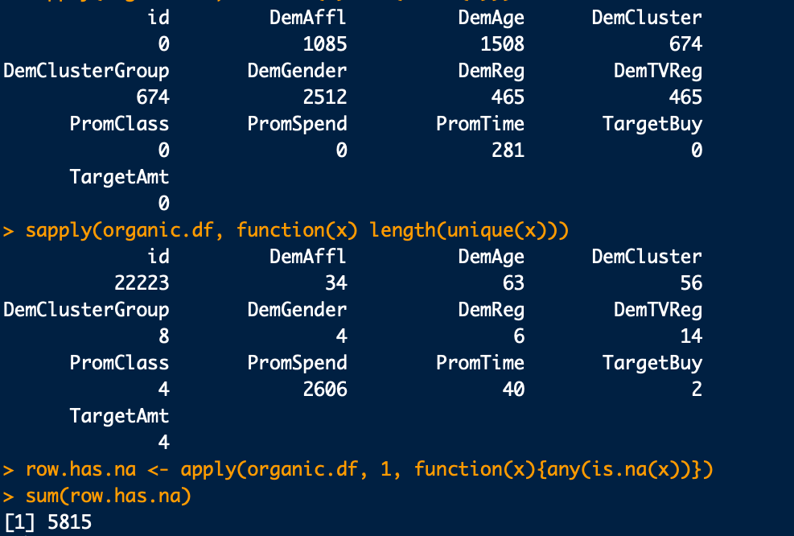
sapply(organic.df,function(x) sum(is.na(x)))
sapply(organic.df, function(x) length(unique(x)))
row.has.na <- apply(organic.df, 1, function(x){any(is.na(x))})
sum(row.has.na)

Slide 6
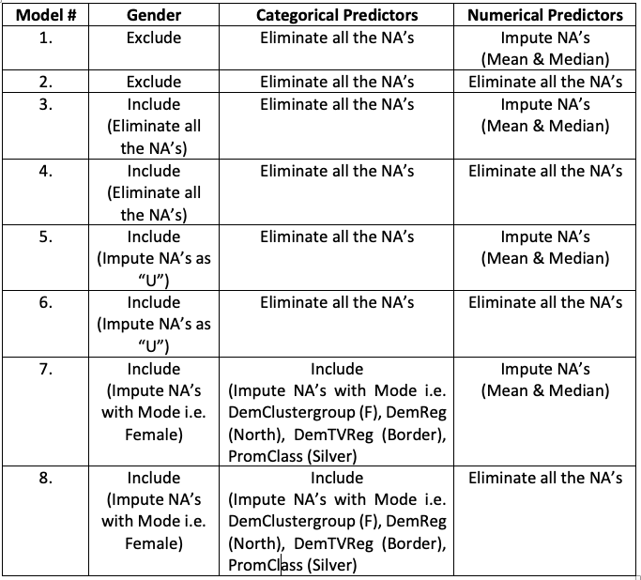
Model iterations

Slide 7

Data Partition & Normalizing
Training data
60%
Dataset
We partitioned the data into training and validation dataset with 60:40 ratio
Also, normalized these dataset for Neural Net and KNN
Validation
40%

Slide 8
Model Assessment
Model # | Logistics | Neural Net | KNN
1 | 79.93 | 80.49 | 77.74
2 | 80.74 | 81.28 | 78.72
3 | 78.82 | 79.86 | 76.68
4 | 80.55 | 80.37 | 77.05
5 | 81.17 | 81.37 | 78.41
6 | 81.90 | 82.09 | 78.78
7 | 81.40 | 81.18 | 77.92
8 | 80.67 | 81.38 | 78.44

Slide 9

Selecting the best model
We ran the stepwise() function to find the significant predictors:
DemAffl + DemAge + PromTime + Unknown + Female + F. + North + Border + Silver
We tried implementing our model with Neural network (accuracy 82.77 %) but were unsuccessful at fetching the results with score-data
Hence, we had to choose logistic regression for our project which has an accuracy of 82.12%

Slide 10
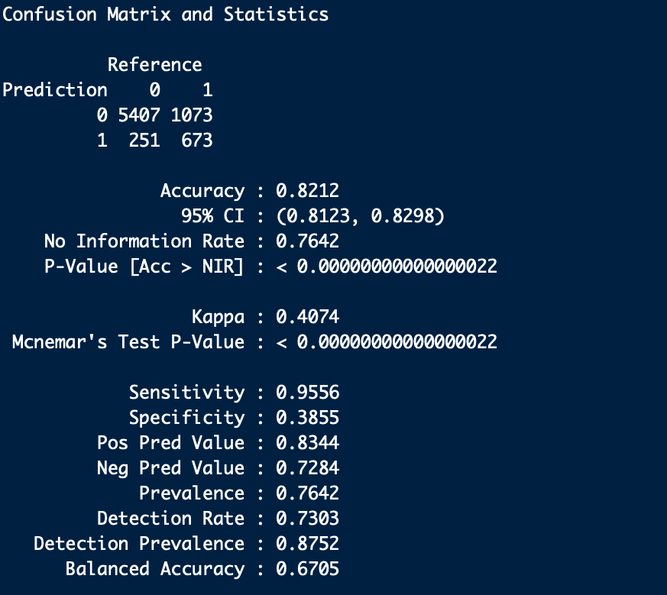
Best Model: Logistic Regression

Slide 11
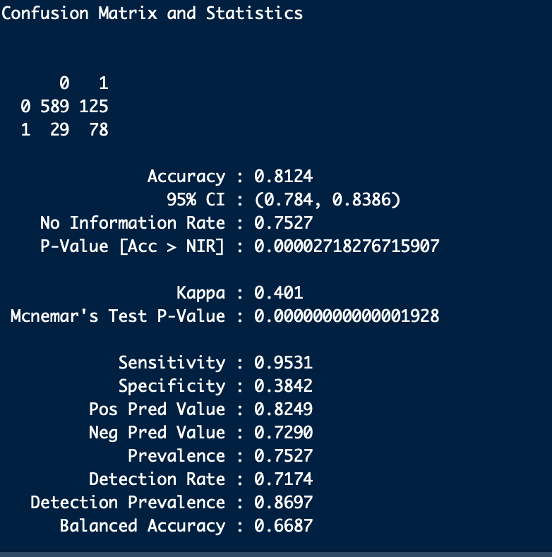
Model Implementation
Running the model on Score data gave us the following output:
Accuracy is 81.24%
Error rate : 1- Accuracy = 18.76%

Slide 12

Result
We observed the following points from our project:
Producing the right logic is as important as writing the right code for the model
Cleaning the dataset could be trickier if one would dive into n number of permutation and combination
Selecting the best predictors could significantly reduce the execution time and boost the accuracy %, thereby reducing errors

